Slide 1
GLOBAL ECONOMY NETWORK: A CROSS COUNTRY ANALYSIS
G
R
O
U
P
5
Michael Albuquerque – Maruthi Ayyappan – Aishwarya Gunde – Ivàn Mera – Beethoven Plaisir

Slide 2
OBJECTIVE
The objective of this project is to enable the user to gain a comprehension of the world’s economy by generating on-demand regression analytical outputs, including graphs.

Slide 3
PROBLEM STATEMENT
Econometrics allows each country to know how much progress they made, how much richer they become, how integrated they are. The strength of the global economy existing GDP reporting resources only display data, other indicators related to them, and provide basic ranking. But they do not provide the possibility to discover what affects GDP growth.
Our program attempts to go beyond this limitation. It runs a regression model for investigating and modelling the relationship between the economic indicators of a country.

Slide 4
INTRODUCTION TO DATASET
For this project, we gather our data from the National Accounts Main Aggregates Database. This database presents for around 200 countries a series of analytical national accounts tables from 1970 onwards. It is the fruit of collaboration between the national statistical services of these countries, the United Nations Statistics Division and some international statistical agencies.
This rich data base can help our users have a clear view of a country economic activity and deep understanding of the evolution of its GDP and its components breakdown at current prices in US Dollars (all countries), listed below:
1. Gross domestic product (GDP) at current prices
2. Final consumption expenditure
3. Exports of goods and services
4. Imports of goods and services
5. Gross capital formation

Slide 5
TOOLS AND METHODS
1. Library: We are using two external libraries along with python standard libraries.
- matplotlib to plot graphs
- statsmodels to do regression analysis on the data
2. File I/O: In the beginning, we shall be reading aforementioned datasets (.csv) files and store them to lists.
The output reports being generated for either country comparison or Regression Analysis will stored in a local specified directly to be viewed later along with the graphs.
3. OOP: We are going to store information about each country GDP in a class.
The GDP class would have attributes that factor and contribute towards the GDP of a country like consumer spending, net exports, and government spending.
We would also have classes that segregate the countries according to regions.
4. Data Structure: Our datasets are largely based on countries and their respective KPIs; this requires that we maintain lists of response i.e. GDP and regressors i.e. KPIs for implementing regression analysis. We also present the data in the form tuple so that user can select index assigned to each country for its evaluation.

Slide 6

CUSTOM LIBRARY FOR ANALYSIS
We created a custom library named filedata that contains two classes inclusive of respective methods.
Class file_data takes two arguments: filename and key. Its get_data method return list of X variables (independent variables or regressors; KPIs in this case) and Y variables (dependent or response; GDP in this case).
The key is the index number associated with a country. It is passed to get_data method to retrieve the X and Y variables of a particular country chosen by the user and based on the entered index number.
Class OLSModel inherits the file_data class. Its olsm method returns result of OLS regression model implemented on the user input.
The external libraries we have implemented are pandas and statsmodels. Pandas is easy-to-use data structures and data analysis tool and statsmodels module allows users to explore data, estimate statistical models, and perform statistical tests.

Slide 7
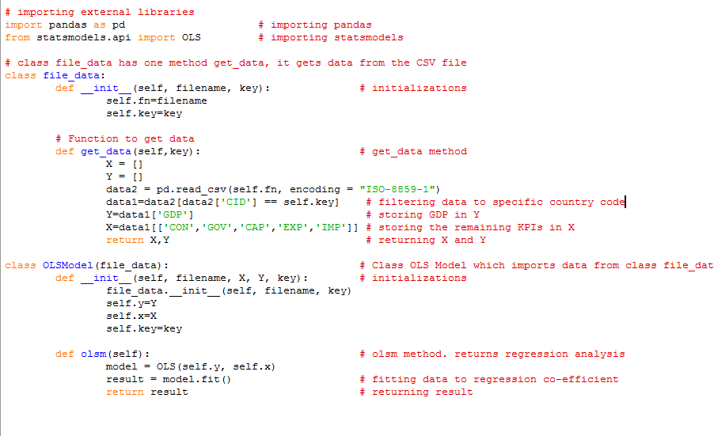
CUSTOM LIBRARY FOR ANALYSIS

Slide 8
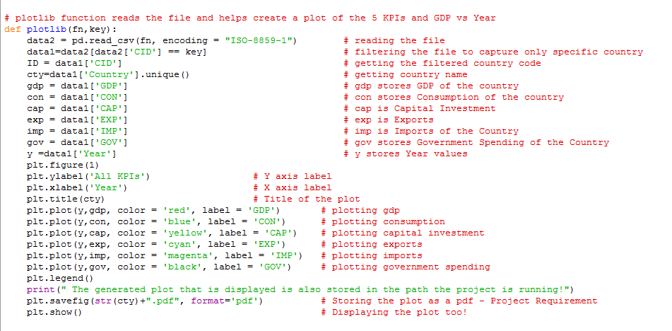
PLOT METHOD FOR KPIs
We created a method called plotlib which reads the file again, and splits the KPIs or Regressors into pandas dataframe columns, it does the process for GDP and Year too. Then we plot the seven variables, 5 KPIs, GDP VS Year.

Slide 9
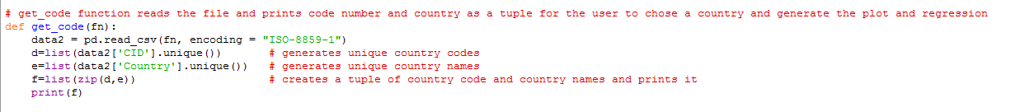
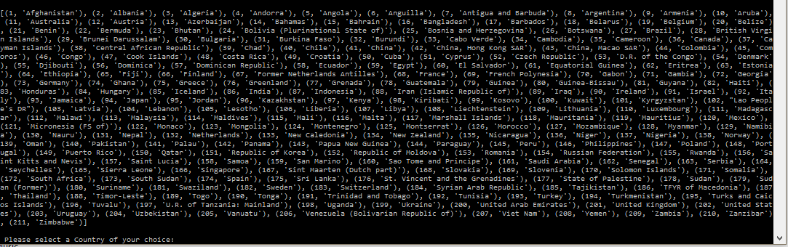
CONSOLE I/O: COUNTRY SELECTION
We created a method called get_code() which prints the values of unique countries and its respective country code as a tuple list to the user from which he/she chooses a specific country on which we produce the plot and do regression analysis on!

Slide 10
CONSOLE I/O: OLS REGRESSION RESULT
As far as regression analysis, we chose to not have a constant Regressors (Y-intercept) since we used all KPI that measure GDP Performance. Our .998 Adjusted R^2 is not surprising since economic theory backs the 5 KPI as the components of GDP.
Based on the coefficients we can see that Afghanistan’s greatest contribution to GDP (considering all available data) has been Government Expenditure.
The coefficient itself is between being statistically significant and not. This is due to the fact that our output represents all of the data ever recorded and does not account for KPI performance changing over time.
Based on the on-going conflict in Afghanistan since the War on Terror, Afghanistan’s reconstruction period and military expenses represent a huge portion of its government spending. The coefficient itself reflects how government spending greatly affects Afghanistan’s GDP.

Slide 11
CONSOLE I/O: OLS REGRESSION RESULT
-By looking more into our table, we can see that the other KPI’s contribution to GDP fall below par from other country KPI performance. Astonishingly, Exports for Afghanistan have a negative impact on GDP, something that goes against economic theory.
-Based on Afghanistan's political conflict and consequential war damages that followed the war on terror, it makes sense that Exports have a negative impact because they have been on the decline for quite some time (more on this on our graph output). Afghanistan has lost its capacity to export and it will be quite sometime before this indicator performs as it should.
-Consumption contributing .55 for every dollar spent shows that consumption unlike the U.S. does not drastically contribute to changes in GDP. However, it is the most statistically significant KPI. That means that we are sure that consumption as KPI, affects and actually contributes to our built model.

Slide 12
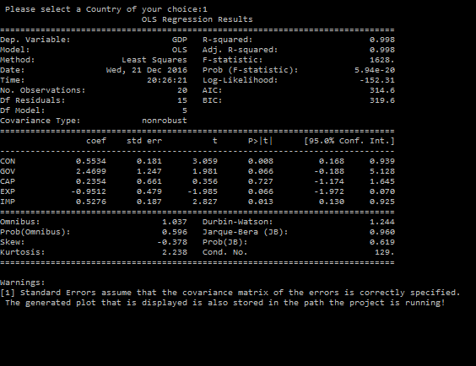
CONSOLE I/O: OLS REGRESSION RESULT

Slide 13
OUTPUT GRAPH: YEARLY EVOLUTION OF KPIs
Our graph offers even more insight. By looking at the graph we are able to substantiate that Consumption is the most statistically significant of all KPI in the case of Afghanistan.
Since the War on terror after 9/11 we see that consumption as a KPI is actually higher than GDP until 2009. It adds to the fact that imports during the war (military industrial complex!) and after represent a large portion of GDP, (higher than exports) and make net exports a negative indicator, subtracting from GDP performance.
Our graph shows that there is a direct relationship between consumption and overall GDP and that consumption changes are a great predictor of economic performance. Variations in consumption go hand in hand with changes in GDP.
Our graph shows that after 2010 Afghanistan’s GDP has risen at an exponential rate. Perhaps due to the receding conflict and its reconstruction efforts. Moreover, improving political stability allow for the economy to recover performance as economic activity improves.

Slide 14
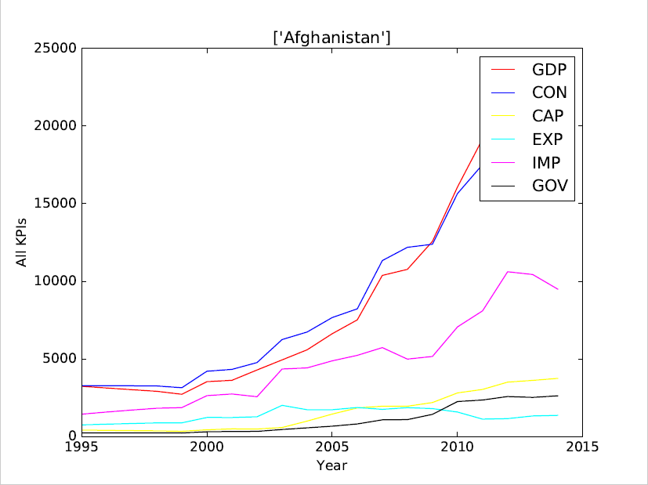
GDP line also shows a tremendous gdp has grown more that 5 times its 1995 value. Whether this is due to actual war efforts, its eventual reconstruction, or actual economic performance is yet to be proved. However, it is hard to see based on GDP alone whether these GDP changes can be considered as Pro-Poor Growth and development.

Slide 15
VIDEO DEMO
https://www.screencast.com/t/K0aZyfEJpTX
Please copy paste above link in browser to view the demo!

Slide 16
CONCLUSION: Moving Forward
Working with a project that can help shape economic policy and make an actual difference in people’s lives was a great way to get our hands dirty with Python. It was pleasure for all of us to take on such a challenge and we hope to have the opportunity of improving our program in the future.
As far as our project goes, we achieved our goals of having a program that can summarize an economists data manipulation and visualization so that the economist can focus more on why these changes occur and what policies can be introduced to improve a country’s GDP performance.
Eventually, we would like to see our program perform cross-country analysis, forecasting, as well as select the years in which the user may run a regression. We are aware that changes in the political climate, political leaders, and the policies that result from these changes greatly alter the composition of GDP and its KPI performance and effects on overall GDP.

Slide 17
THANK YOU

